Slide 1


Uppalaiah Erugu
02.20.2024

Slide 2

Outline
Executive Summary
Introduction
Methodology
Results
Conclusion
Appendix

Slide 3
Executive Summary
The Capstone project follows and presents below methodologies and results
Summary of methodologies
Data Collection
Data Wrangling
Exploratory Data Analysis
Interactive Visual Analytics
Predictive Analysis
Summary of all results
Exploratory Data Analysis (EDA) results
Geospatial analytics
Interactive dashboard
Predictive analysis of classification models

Slide 4
Introduction
SpaceX launches Falcon 9 rockets at a cost of $62millions while its competitors launches at cost of $165millions. This is much cheaper due to fact that SpaceX can land, and then re-use the first stage of the rocket.
If we can predict whether the first stage lands successfully or not, the cost of a launch can be determined and this information can used to assess whether or not an alternate company should bid and SpaceX for a rocket launch.
In this capstone project, the predictions on if the SpaceX Falcon 9 first stage lands successfully are made using classification models.

Slide 5

Section 1

Slide 6
Methodology
Executive Summary
Data collection methodology:
Making GET requests to the SpaceX REST API
Web Scraping
Perform data wrangling
Used the .fillna() method to handle missing values
Used the .value_counts() method to determine the following:
Number of launches on each site
Number and occurrence of each orbit
Number and occurrence of mission outcome per orbit type
Created a landing outcome labels for successful and failed booster landings
Perform exploratory data analysis (EDA) using visualization and SQL
Used SQL queries to manipulate and analyze the SpaceX dataset
Used Pandas and Matplotlib to visualize relationships between variables, and determine patterns
Perform interactive visual analytics using Folium and Plotly Dash
Geospatial analytics using Folium
Creating an interactive dashboard using Plotly Dash

Slide 7
Methodology
Perform predictive analysis using classification models
Used Scikit-Learn to:
Pre-process (standardize) the data
Split the data into training and testing data using train_test_split()
Train different classification models
Find the best hyperparameters using GridSearchCV
Plotting confusion matrices for each classification model
Assessing the accuracy of each classification model

Slide 8
Data Collection
Data was collected using following methods
Making GET requests to the SpaceX REST API
Web Scraping

Slide 9
Data Collection – SpaceX API
Make a GET response to the SpaceX REST API
Convert the response to a .json file then to a Pandas DataFrame
SpaceX API is used to retrieve data about rocket launches, payloads, landing specifications, and landing outcomes.
Use custom logic to clean the data
Define lists for data to be stored in
Call custom functions to retrieve data and fill the lists
Use these lists as values in a dictionary and construct the dataset
Create a Pandas DataFrame from the constructed dictionary dataset
https://github.com/eruguUppi/Capstone-Project/blob/main/1.%20Data%20Collection%20-%20API.ipynb
Filter the DataFrame to only include Falcon 9 launches
Reset the FlightNumber column
Replace missing values of PayloadMass with the mean PayloadMass value

Slide 10
Data Collection - Scraping
Web scraping was used to collect Falcon 9 historical launch records from a Wikipedia page titled List of Falcon 9 and Falcon Heavy launches.
Request the HTML page from the static URL
Assign the response to an object
Create a BeautifulSoup object from the HTML response object
Find all tables within the HTML page
Collect all column header names from the tables found within the HTML page
https://github.com/eruguUppi/Capstone-Project/blob/main/1.%20Data%20Collection%20-%20Web%20Scraping.ipynb
Use the column names as keys in a dictionary
Use custom functions and logic to parse all launch tables to fill the dictionary values
Convert the dictionary to a Pandas DataFrame ready for export

Slide 11
Data Wrangling
In order to transform the raw data into usable format
Handle missing values are using .fillna() method
Use the .value_counts() method to determine the following:
Number of launches on each site
Number and occurrence of each orbit
Number and occurrence of mission outcome per orbit type
Label landing outcomes as 1 for successful ones and 0 for failed ones
https://github.com/eruguUppi/Capstone-Project/blob/main/2.%20Data%20Wrangling.ipynb
Export the DataFrame as a .csv file

Slide 12
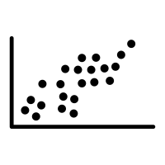


EDA with Data Visualization
Scatter charts were created to visualize the relationships between:
Flight Number Vs Launch Site
Payload Vs Launch Site
Orbit Type Vs Flight Number
Payload Vs Orbit Type
Scatter Plots
Scatter plots are help us to observe relationships or correlations, between two numeric variables.
Bar Plots
It presents categorical data with rectangular bars with length proportional to the values they represent.
A bar chart was produced to visualize the relationship between:
Success Rate and Orbit Type
Line Plots
Line charts were created to visualize the relationships between:
Success Rate and Year (i.e. the launch success yearly trend)
It connects the data points that display quantitative values over a period of time interval
https://github.com/eruguUppi/Capstone-Project/blob/main/3.%20Exploratory%20Data%20Analysis%20-%20Data%20Visualization.ipynb

Slide 13
EDA with SQL
To understand and analyze the dataset, SQL queries are performed for following purposes
Display the names of the unique launch sites of SpaceX
Display 5 records where launch sites begin with the string ‘CCA’
Display the total payload mass carried by boosters launched by NASA (CRS)
Display the average payload mass carried by booster version F9 v1.1
List the date when the first successful landing outcome on a ground pad was achieved
List the names of the boosters which had success on a drone ship and a payload mass between 4000 and 6000 kg
List the total number of successful and failed mission outcomes
List the names of the booster versions which have carried the maximum payload mass
List the failed landing outcomes on drone ships, their booster versions, and launch site names for 2015
Rank the count of landing outcomes (such as Failure (drone ship) or Success (ground pad)) between the date 2010-06-04 and 2017-03-20, in descending order
https://github.com/eruguUppi/Capstone-Project/blob/main/3.%20Exploratory%20Data%20Analysis%20-%20SQL.ipynb

Slide 14
Build an Interactive Map with Folium
To visualize the launch data on an interactive map, the following steps or objects are added:
Mark all launch sites on a map
Initialise the map using a Folium Map object
Add a folium.Circle and folium.Marker for each launch site on the launch map
Mark the success/failed launches for each site on a map
Since most launches have the same coordinates, these locations are clustered together.
Before clustering them, assign a marker colour of successful (class = 1) as green, and failed (class = 0) as red.
To put the launches into clusters, for each launch, add a folium.Marker to the MarkerCluster() object.
Create an icon as a text label, assigning the icon_color as the marker_colour determined previously.
Calculate the distances between a launch site to its proximities
To explore the proximities of launch sites, calculations of distances between points can be made using the Lat and Long values.
After marking a point using the Lat and Long values, create a folium.Marker object to show the distance.
To display the distance line between two points, draw a folium.PolyLine and add this to the map.
https://github.com/eruguUppi/Capstone-Project/blob/main/4.%20Interactive%20Visual%20Analytics%20-%20Folium.ipynb

Slide 15
Build a Dashboard with Plotly Dash
The following plots and interactions were added to a Plotly Dash dashboard:
Pie chart (px.pie()) to show the total successful launches per site
This makes it clear to see which sites are most successful
The chart could also be filtered (using a dcc.Dropdown() object) to see the success/failure ratio for an individual site
Scatter graph (px.scatter()) to show the correlation between outcome (success or fail) and payload mass (kg)
This could be filtered (using a RangeSlider() object) by ranges of payload masses
It could also be filtered by booster version
https://github.com/eruguUppi/Capstone-Project/blob/main/4.%20Interactive%20Visual%20Analytics%20-%20Plotly%20Dash%20dashboard.py

Slide 16
Predictive Analysis (Classification)
To develop, evaluate, and find the best performing classification model, the below steps were followed:
Model Evaluation
Find the Best Classification Model
Model Development
To prepare the dataset for model development:
Load dataset
Perform necessary data transformations (standardise and pre-process)
Split data into training and test data sets, using train_test_split()
Decide which type of machine learning algorithms are most appropriate
For each chosen algorithm:
Create a GridSearchCV object and a dictionary of parameters
Fit the object to the parameters
Use the training data set to train the model
For each chosen algorithm:
Using the output GridSearchCV object:
Check the tuned hyperparameters (best_params_)
Check the accuracy (score and best_score_)
Plot and examine the Confusion Matrix
Review the accuracy scores for all chosen algorithms
The model with the highest accuracy score is determined as the best performing model
https://github.com/eruguUppi/Capstone-Project/blob/main/5.%20Predictive%20Analysic%20-%20Classification.ipynb

Slide 17
Results
Exploratory Data Analysis Results
Interactive Analysis Results
Predictive Analysis Results

Slide 18

Section 2

Slide 19
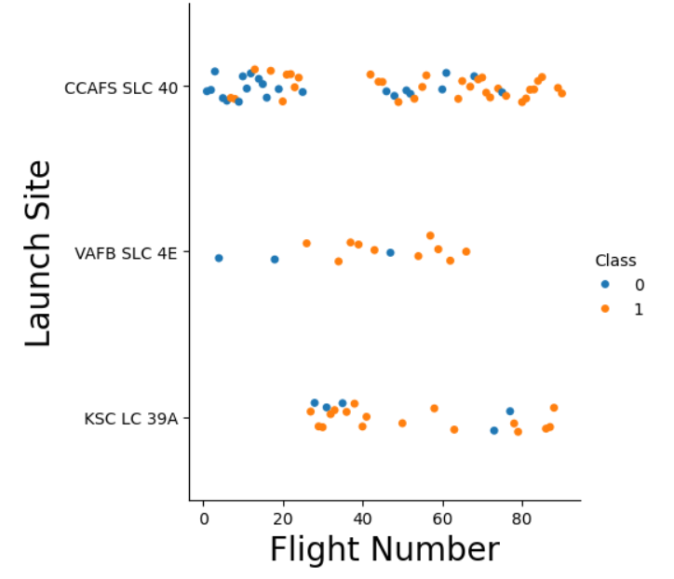
Flight Number vs. Launch Site
The scatter plot of Launch Site vs. Flight Number reveals that:
The rate of success at a launch site increases with the number of flights
Most of the early are launched from CCAFS SLC 40, and are unsuccessful.
The flights from VAFB SLC 4E also show this trend, that earlier flights are less successful.
No early flights are launched from KSC LC 39A, so the launches from this site are more successful.
Above a flight number of around 30, there are significantly more successful landings (Class = 1).

Slide 20
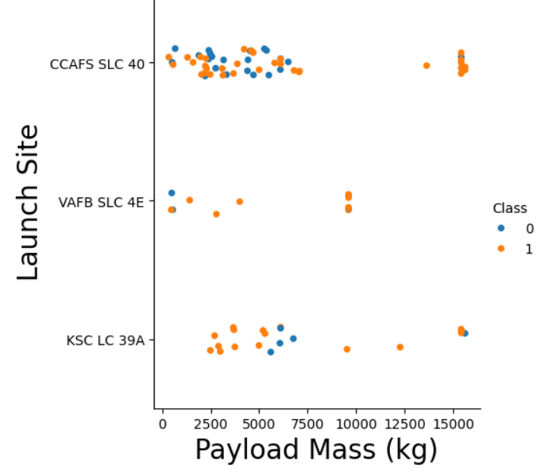
Payload vs. Launch Site
The scatter plot of Launch Site vs. Payload Mass shows that:
Most of landings are successful above a payload mass of around 7000 kg
There are a very few heavier launches and are successful too
There is no clear correlation between payload mass and success rate for a given launch site but the launches from VAFB SLC 4E are mostly successful for all payloads
All sites launched a variety of payload masses, with most of the launches from CCAFS SLC 40 being comparatively lighter payloads

Slide 21
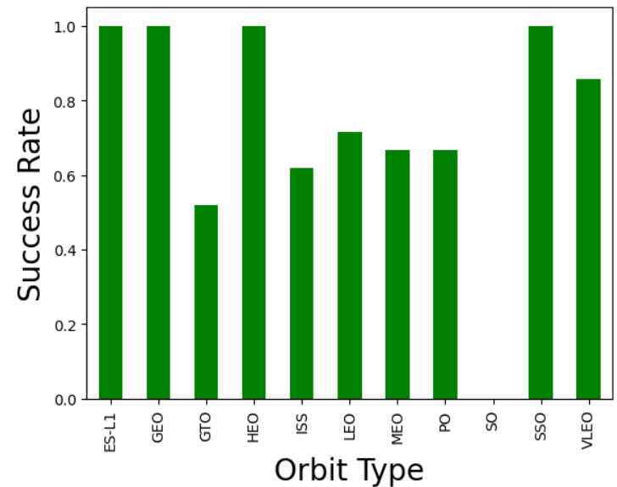
Success Rate vs. Orbit Type
The bar chart of Success Rate vs. Orbit Type shows that the following orbits have the highest (100%) success rate:
ES-L1 (Earth-Sun First Lagrangian Point)
GEO (Geostationary Orbit)
HEO (High Earth Orbit)
SSO (Sun-synchronous Orbit)
The orbit with the lowest (0%) success rate is:
SO (Heliocentric Orbit)

Slide 22
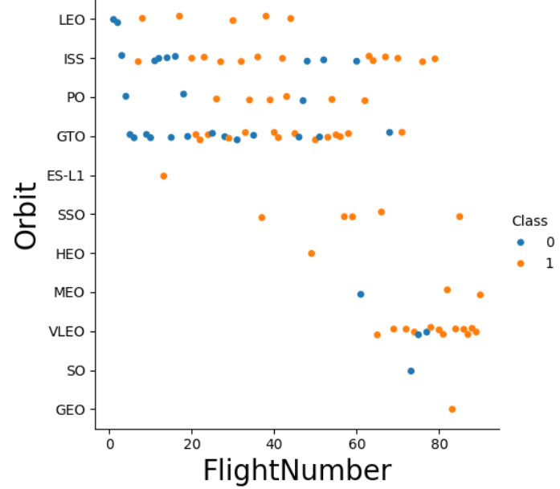
Flight Number vs. Orbit Type
Scatter plot of Orbit Type vs. Flight number shows:
GEO, HEO, and ES-L1 orbits have 100% success rate with only one launch.
The 100% success rate of SSO launch is impressive with all successful flights.
No relationship between Flight Number and Success Rate for GTO is found.
The success rate of booster landings seems to increase with Flight Number in all launches except in GTO.

Slide 23
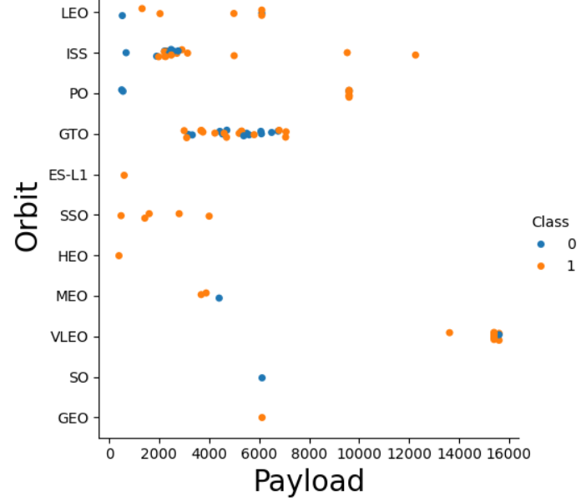
Payload vs. Orbit Type
Scatter plot of Orbit Type vs. Payload Mass shows that:
For heavy payloads below orbit launches’ booster landings are successful:
PO
ISS
LEO
For GTO, no relationship between payload mass and success rate is found.
All booster landings are successful for SSO launches of all Payloads
VLEO (Very Low Earth Orbit) launches are associated with heavier payloads.

Slide 24
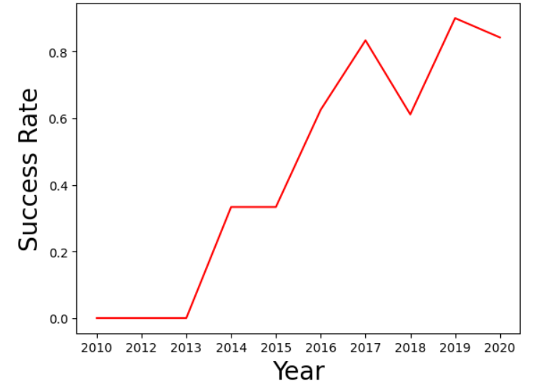
Launch Success Yearly Trend
The line chart of yearly average success rate shows that:
Before 2013, all booster landings are unsuccessful
After 2013, the success rate increased, despite small dips in 2018 and 2020
After 2016, the booster landings have more 50% of success rate
It indicates that SpaceX has mastered the technology of landing first stage boosters for reuse

Slide 25
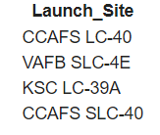
All Launch Site Names - EDA with SQL
SQL query:
Output:
The UNIQUE constraint returns only unique values from the LAUNCH_SITE column of the SPACEXTBL table.

Slide 26
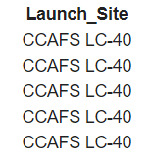
Launch Site Names Begin with 'CCA'
Find 5 records where launch sites begin with `CCA`
SQL query:
Output:
LIMIT 5 fetches only 5 records, and the LIKE keyword is used with the wild card ‘CCA%’ to retrieve string values beginning with ‘CCA’.

Slide 27
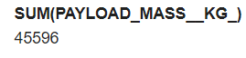
Total Payload Mass
Calculate the total payload carried by boosters from NASA
SQL query:
Output:
The SUM keyword is used to calculate the total of the LAUNCH column, and the WHERE clause is used to filter the results to only boosters from NASA (CRS).

Slide 28
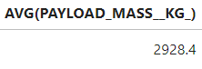
Average Payload Mass by F9 v1.1
Calculate the average payload mass carried by booster version F9 v1.1
SQL query:
Output:
The AVG() function is used to calculate the average of the PAYLOAD_MASS__KG_ column, and the WHERE clause filters the results to only the F9 v1.1 booster version.

Slide 29
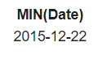
First Successful Ground Landing Date
Find the dates of the first successful landing outcome on ground pad
SQL query:
Output:
The MIN() function is used to calculate the minimum of the DATE column, i.e. the first date, and the WHERE clause filters the results to only the successful ground pad landings.

Slide 30
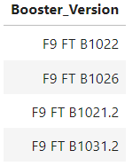
Successful Drone Ship Landing with Payload between 4000 and 6000
List the names of boosters which have successfully landed on drone ship and had payload mass greater than 4000 but less than 6000
SQL query:
Output:
The WHERE clause is used to filter the results to include only those that satisfy both conditions. The BETWEEN keyword allows for 4000 < x < 6000 values to be selected.

Slide 31
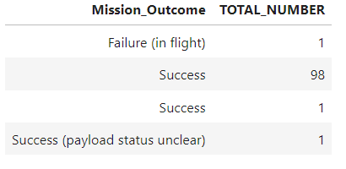
Total Number of Successful and Failure Mission Outcomes
Calculate the total number of successful and failure mission outcomes
SQL query:
Output:
The COUNT function is used to calculate the total number of mission outcomes, and the GROUPBY statement is also used to group these results by the type of mission outcome.

Slide 32
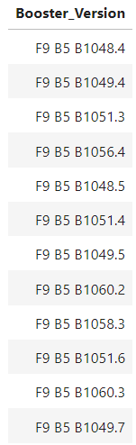
Boosters Carried Maximum Payload
List the names of the booster which have carried the maximum payload mass
SQL query:
Output:
A subquery is used here. The SELECT statement within the brackets finds the maximum payload, and this value is used in the WHERE condition. The DISTINCT keyword is then used to retrieve only distinct /unique booster versions.

Slide 33
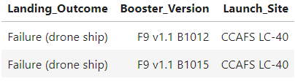
2015 Launch Records
List the failed landing_outcomes in drone ship, their booster versions, and launch site names for in year 2015
SQL query:
Output:
The WHERE clause is used to filter the results for only failed landing outcomes, AND only for the year of 2015.

Slide 34
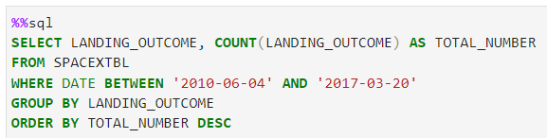
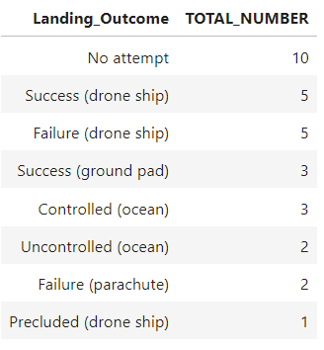
Rank Landing Outcomes Between 2010-06-04 and 2017-03-20
Rank the count of landing outcomes (such as Failure (drone ship) or Success (ground pad)) between the date 2010-06-04 and 2017-03-20, in descending order
SQL query:
Output:
The WHERE clause is used with the BETWEEN keyword to filter the results to dates only within those specified. The results are then grouped and ordered, using the keywords GROUP BY and ORDER BY, respectively, where DESC is used to specify the descending order.

Slide 35

Section 3

Slide 36
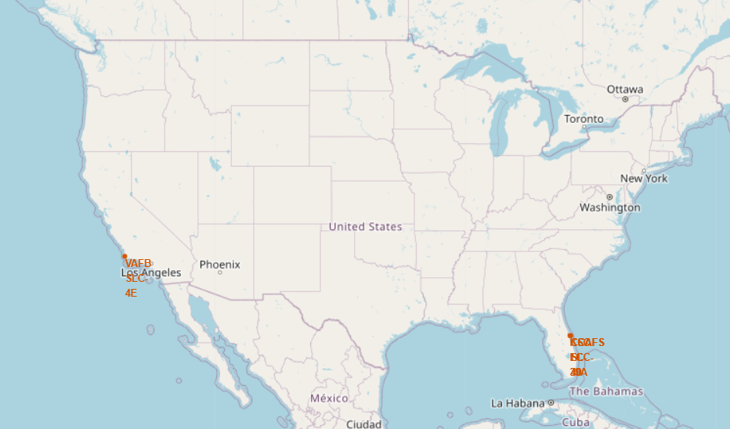
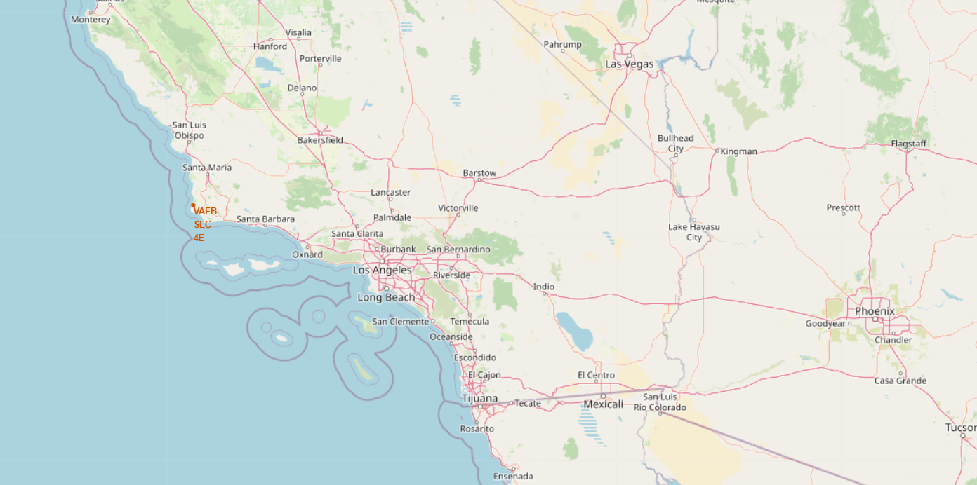
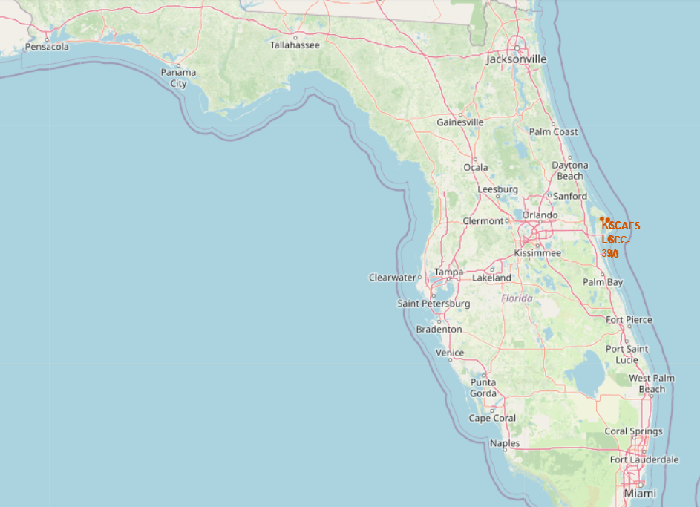
All SpaceX Launch Sites
All SpaceX launch sites are on coasts of Florida and California, USA.
USA
California
Florida

Slide 37
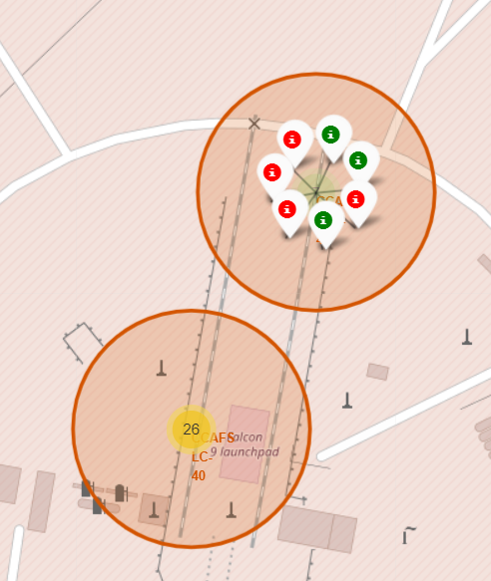
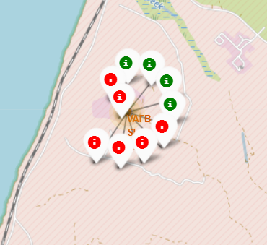
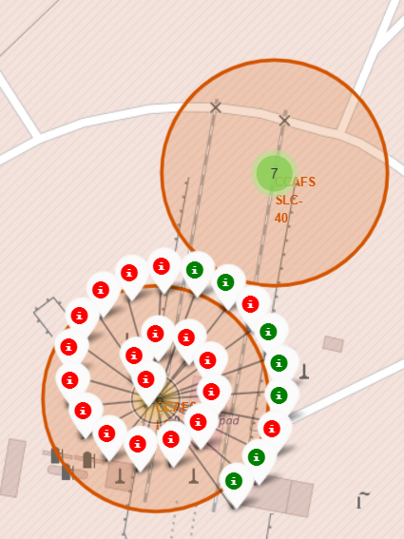
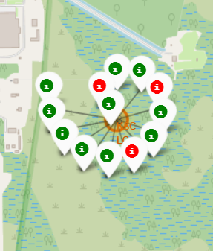
Success/Failed Launches for Each Site
CCAFS SLC-40
Launches have been grouped into clusters, and annotated with green icons for successful landings, and red icons for failed ones.
USA
CCAFS LC-40
VAFB SLC-4E
CCAFS SLC-40
KSC LC-39A
CCAFS LC-40

Slide 38
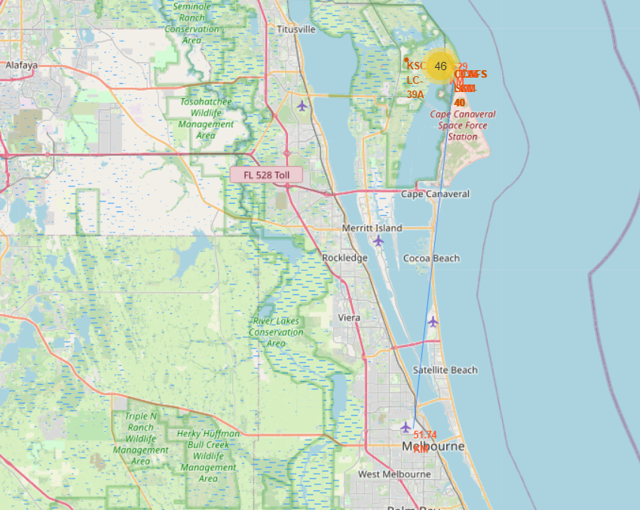
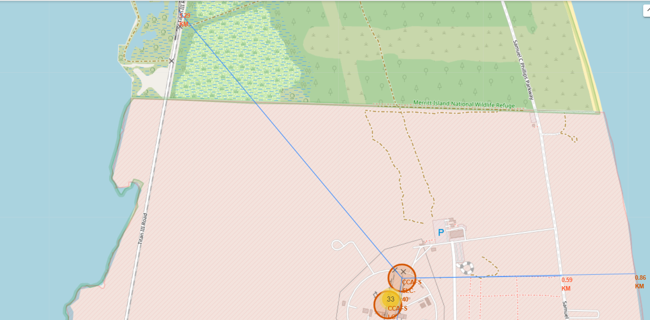
Proximity of Launch Sites to Other Points of Interest
Using the CCAFS SLC-40 launch site as an example site, the distance between launch site, and nearby highway, coastline, railroad and city are calculated.
Are launch sites in close proximity to railways?
YES. The coastline is only 0.86 km due East.
Are launch sites in close proximity to highways?
YES. The nearest highway is only 0.59km away.
Are launch sites in close proximity to railways?
YES. The nearest railway is only 1.29 km away.
Do launch sites keep certain distance away from cities?
YES. The nearest city is 51.4 km away.

Slide 39

Section 4

Slide 40
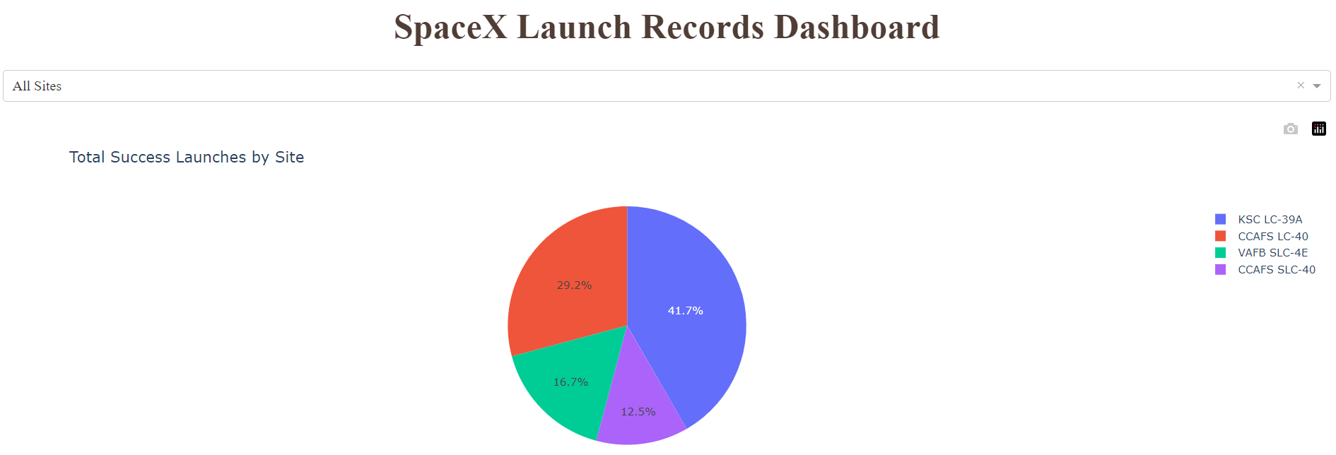
Launch Success Count for All Cities
The launch site KSC LC-39A had the most successful launches, with 41.7% success rate.

Slide 41
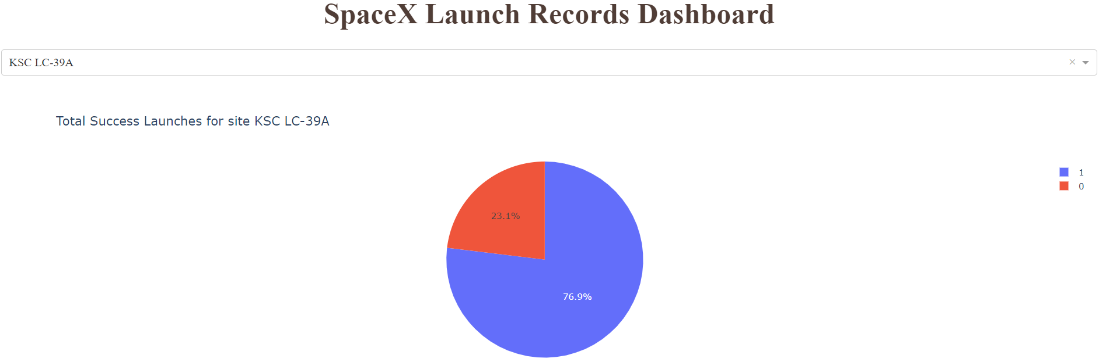
Pie Chart for the Launch Site with the Highest Launch Success Ratio
The launch site KSC LC-39A also had the highest rate of successful launches, with a 76.9% success rate for 1st stage booster landings.

Slide 42
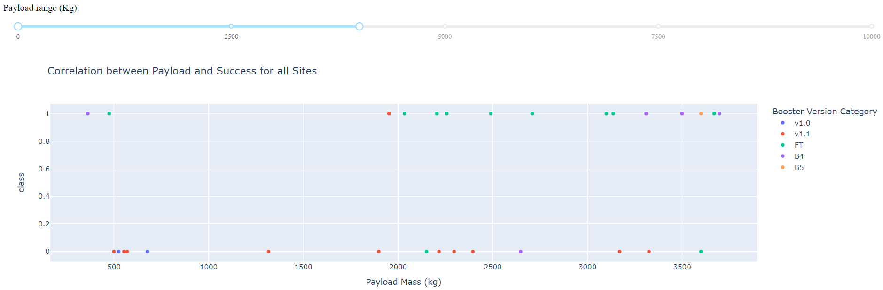
Payload vs Launch Outcome Scatter Plot for All Sites
Low payloads : 0 – 4000 kg
From the Payload vs Launch outcome plot for all sites, the data is divided into two ranges:
Low payloads : 0 – 4000 kg
Massive payloads: 4000 – 10000 kg
For low payloads, the number of successful landings are relatively greater than failed ones

Slide 43
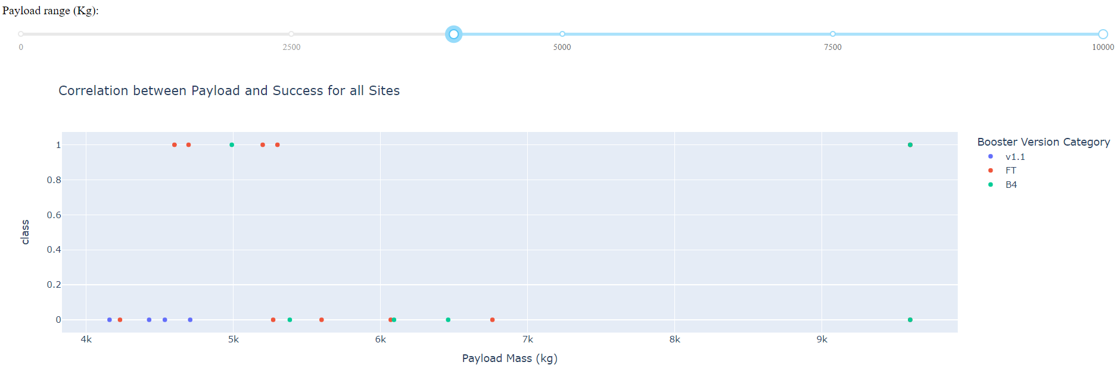
Payload vs Launch Outcome Scatter Plot for All Sites
Massive payloads: 4000 – 10000 kg
For massive payloads, the number of successful landings are less than failed ones
It is evident from the plots that the success for massive payloads is lower than that for low payloads.
It is also worth noting that some booster types (v1.0 and B5) have not been launched with massive payloads.

Slide 44

Section 5

Slide 45
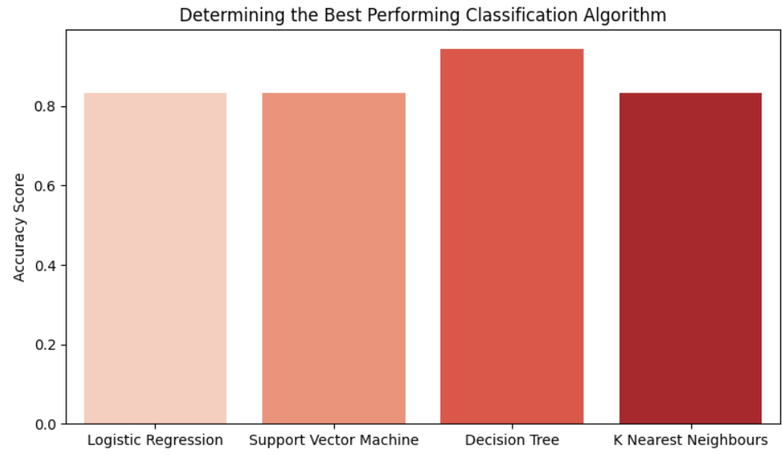
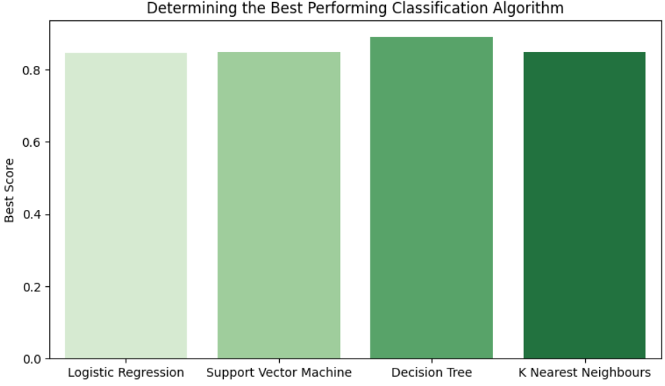
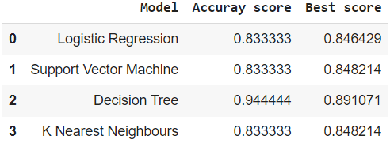
Classification Accuracy
From the Accuracy scores and Best scores of all classification models:
The Decision Tree model has the highest classification accuracy
The Accuracy Score is 94.44%
The Best Score is 89.1%

Slide 46
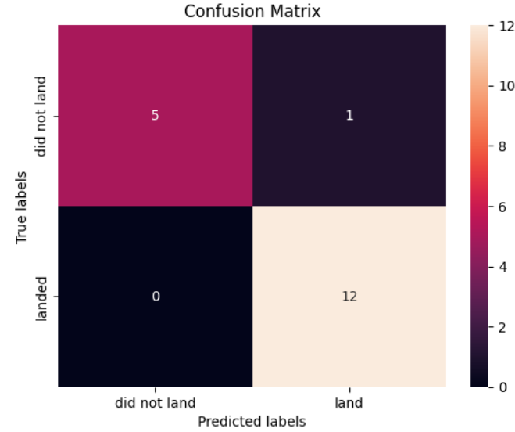
Confusion Matrix
The best performing classification model is the Decision Tree model, with an accuracy of 94.44%.
The confusion matrix shows that only 1 out of 18 total results classified incorrectly (a false positive) by Decision Tree model.
The other 17 results are correctly classified (5 did not land, 12 did land) by Decision Tree model.
https://github.com/eruguUppi/Capstone-Project/blob/main/5.%20Predictive%20Analysic%20-%20Classification.ipynb

Slide 47
Conclusions
The rate of success at a launch site increases with number of flights, the early flights being unsuccessful.
Before 2013, all booster landings are unsuccessful.
After 2013, the success rate increased, despite small dips in 2018 and 2020.
After 2016, the booster landings have success rate greater than 50%
Above a flight number of around 30, there are significantly more successful landings (Class = 1).
Orbit types ES-L1, GEO, HEO, and SSO, have the highest (100%) success rate.
GEO, HEO, and ES-L1 orbits have 100% success rate with only one launch.
The 100% success rate in SSO is more impressive, with 5 successful flights.
The orbit types PO, ISS, and LEO, have more success with heavy payloads:
VLEO (Very Low Earth Orbit) launches are associated with heavier payloads
The launch site KSC LC-39 A had the most successful launches, with 41.7% of the total successful launches, and also the highest rate of successful launches, with a 76.9% success rate.
The success for massive payloads (over 4000kg) is lower than that for low payloads.
The best performing classification model is the Decision Tree model, with an accuracy of 94.44%.

Slide 48
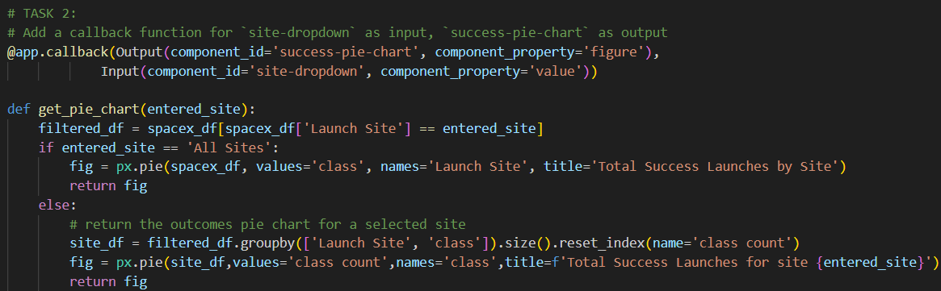
Appendix
Adding a callback function to render Success Pie Chart based selected launch site dropdown

Slide 49
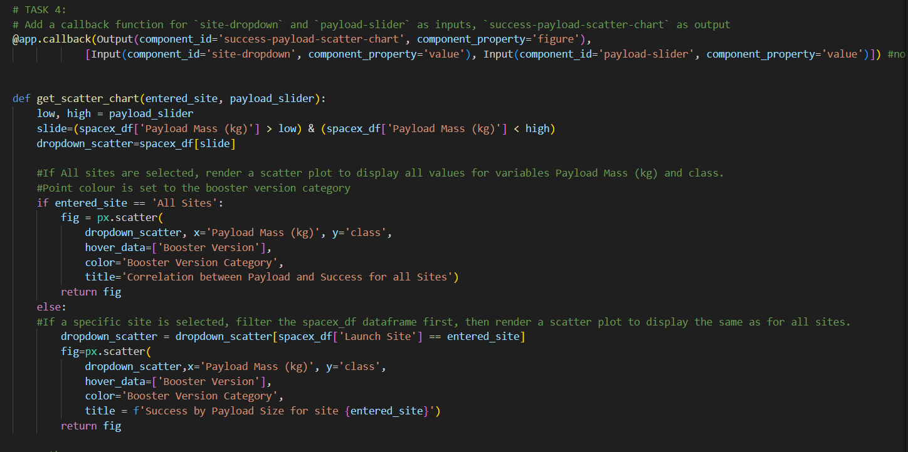
Appendix
Adding a callback function to render Success rate vs Payload Scatter plot

Slide 50


